Slide 1

Apollo
Cameron Maywood, Daniel Holmes, Tyler Aratani, Jaden Grossman, Zhaozhong Peng

Slide 2


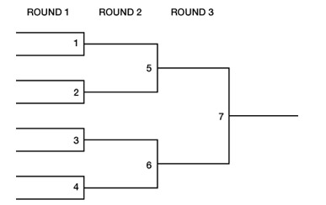
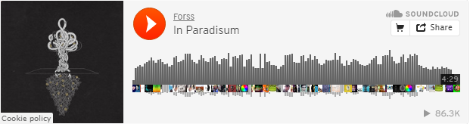
Overview
Purpose:
Provide users with engaging medium for music discovery.
Provide artists with competitive, high-exposure music platform.
Function:
Bracket-style tournaments.
SoundCloud API integration.

Slide 3







Primary Tools
Tool | Platform | Ranking (0 - 5)
Project Tracker | Trello | 3
VCS Repository | GitHub | 4
Deployment Environment | Apache/ FileZilla | 4
Frontend | HTML/CSS | 5
Backend | Parse | 5
Testing | PHPUnit | 3
Notes:
Project -
VCS -
Deployment -
Database -
Frontend - super easy, bootstrap
Testing - couldnt test all PHP functionality but helpful for certain things (e.g. profile pic size/format)

Slide 4
Primary Tools
Tool | Platform | Ranking (0 - 5)
Project Tracker | Trello | 3
VCS Repository | GitHub | 4
Deployment Environment | Apache/ FileZilla | 4
Frontend | HTML/CSS | 5
Backend | Parse | 5
Testing | PHPUnit | 3
Notes:
Highlight tools that we can show visually.

Slide 5
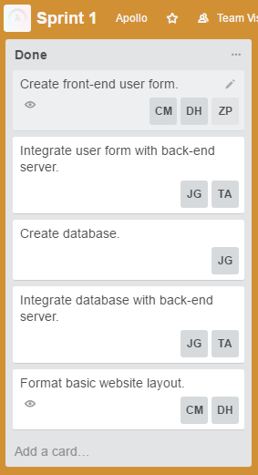
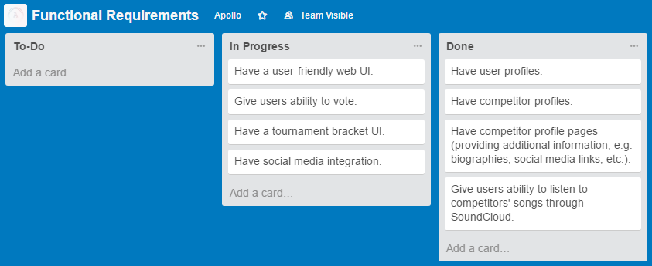
Trello

Slide 6
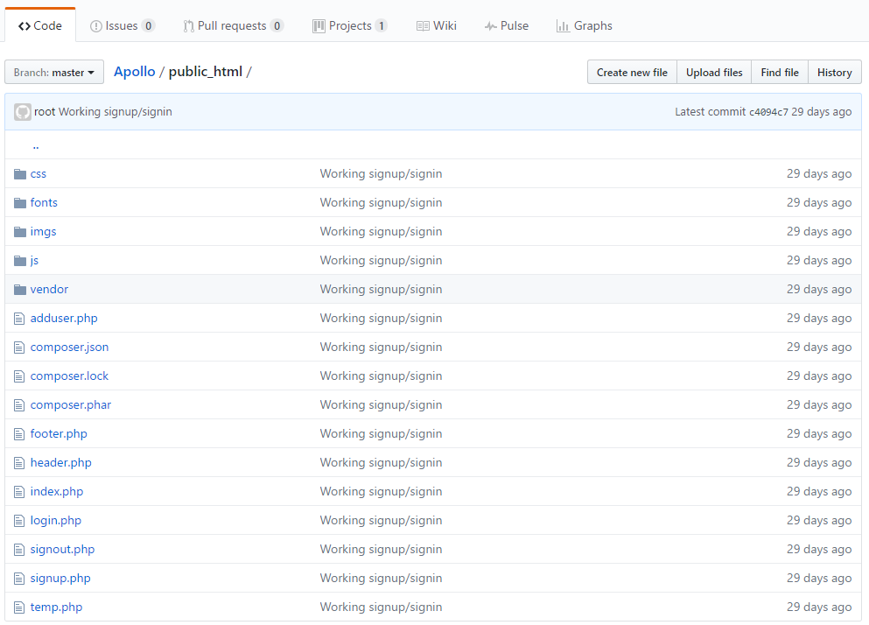
GitHub

Slide 7
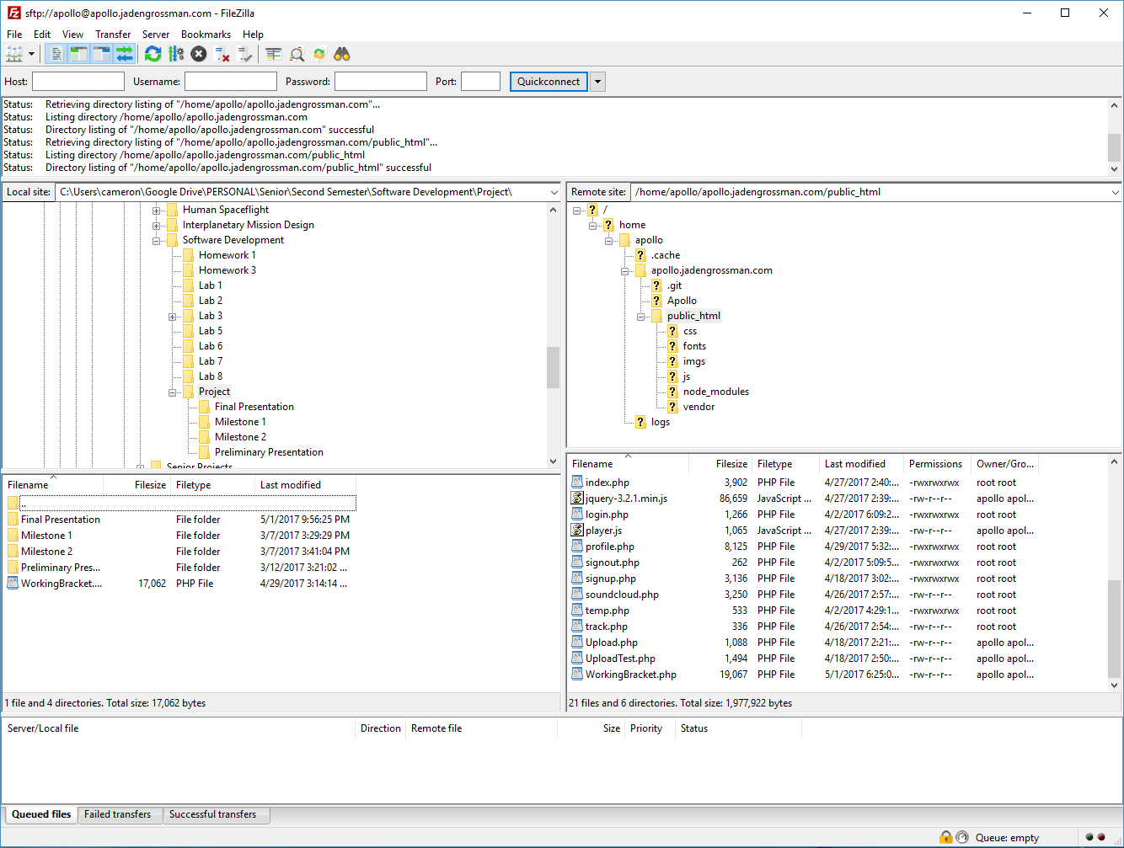
FileZilla

Slide 8
Primary Tools
Tool | Platform | Ranking (0 - 5)
Project Tracker | Trello | 3
VCS Repository | GitHub | 4
Deployment Environment | Apache/ FileZilla | 4
Frontend | HTML/CSS | 5
Backend | Parse | 5
Testing | PHPUnit | 3
Notes:
Talk about database, frontend, and testing.

Slide 9





Additional Tools
Tool | Platform | Ranking (0 - 5)
Database | MongoDB | N/A
File Storage | Google Drive | 5
Communication | Slack | 5
IDEs | Sublime | 5
Design | Photoshop | 4
Notes:
Talk about other tools that helped us.

Slide 10
Methodologies

Slide 11
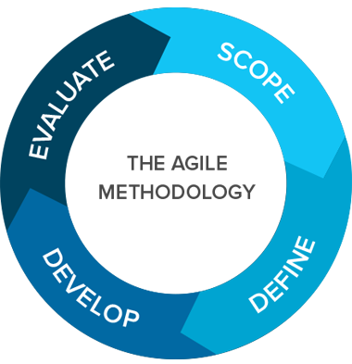
Agile

Slide 12
Agile
Small milestones throughout the semester.
Allowed integration of new ideas.
Goals could change when obstacles were met.
Notes:
Talk about how agile helped us make incremental progress and how we reviewed each others’ work to find issues and improvements.

Slide 13

Peer Code Review

Slide 14
Peer Code Review
Errors and improvements found.
Made code more organized.
Led to new ideas.
Notes:
Talk about how agile helped us make incremental progress and how we reviewed each others’ work to find issues and improvements.

Slide 15
Challenges & Lessons Learned
API Approval
Long waiting period with large companies.
API Integration
Unfamiliar tools and implementations.
Communication
Crucial to making progress, especially w/ Agile.

Slide 16
DEMO

